Slide 1
Puzzle of the day
public class Name {
private final String first, last;
public Name(String first, String last) {
this.first = first;
this.last = last;
}
public boolean equals(Object o) {
if (!(o instanceof Name))
return false;
Name n = (Name) o;
return n.first.equals(first) && n.last.equals(last);
}
public static void main(String[] args) {
Set<Name> s = new HashSet<Name>();
s.add(new Name("Mickey", "Mouse"));
System.out.println(s.contains(new Name("Mickey", "Mouse")));
}
}
Notes:
The bug is that Name violates the hashCode contract. This might seem strange, as Name doesn’t even have a hashCode method, but that is precisely the problem. The Name class overrides the equals method, and the hashCode contract demands that equal objects have equal hash codes. To fulfill this contract, you must override hashCode whenever you override equals [EJ Item 8].
http://docs.oracle.com/javase/7/docs/api/java/lang/Object.html#equals(java.lang.Object).
Because it fails to override hashCode, the Name class inherits its hashCode implementation from Object. This implementation returns an identity-based hash code. In other words, distinct objects are likely to have unequal hash values, even if they are equal. Name does not fulfill the hashCode contract, so the behavior of a hash set containing Name elements is unspecified. When the program puts the first Name instance into the hash set, the set puts an entry for this instance into a hash bucket. The set chooses the hash bucket based on the hash value of the instance, as computed by its hashCode method. When it checks whether the second Name instance is contained in the hash set, the program chooses which bucket to search based on the hash value of the second instance. Because the second instance is distinct from the first, it is likely to have a different hash value. If the two hash values map to different buckets, the contains method will return false: The beloved rodent is in the hash set, but the set can’t find him.
Reflecting on last week’s lab, you can see why secret contracts like this are bad. The language gave us no hint that read would return -1.

Slide 2
Outline
Why Decorator and Factory seem... different
Questions on the reading
Context: Factory Method
Putting the reading in context
Design Studio
Lab 4

Slide 3
Why Decorator and Factory see… different
Behavioral
Strategy
Observer
Structural
Decorator
Creational
Factory Method
Abstract Factory
Notes:
Decorator: we could add the new condiments to the drinks by keeping a list – but that wasn’t the point.
Notice what is not in the list: Simple Factory.

Slide 4
Questions on the reading…
When should factories be used for in our programs? Should they be used for every new object created?
I still feel like I don't understand when you would really use a factory in actual coding, are there any more realistic examples that we could go over?

Slide 5
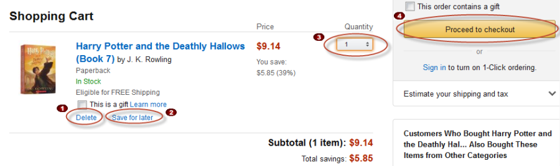
Realistic example: line items (Clean Code)
Imagine you are working on Amazon.com’s shopping cart.
Each item in the cart is a “LineItem.”

Slide 6
Realistic example: line items (Clean Code)
Imagine you are working on Amazon.com’s shopping cart.
Each item in the cart is a “LineItem.”
You want test the cart.
By creating FakeLineItems
Which are instrumented so when the test script clicks the line item, a certain test passes.
How about this?
Make a SimpleLineItemFactory with one method, createLineItem.
Whenever we want to test our code, we edit createLineItem and replace the creation of real LineItems with FakeLineItems.
Whenever we deploy, we edit the code back the way it was.

Slide 7
Realistic example: line items (Clean Code)
Imagine you are working on Amazon.com’s shopping cart.
Each item in the cart is a “LineItem.”
You want test the cart.
By creating FakeLineItems
Which are instrumented so when the test script clicks the line item, a certain test passes.
Amazon starts selling cars
Cars need completely different CarLineItems to show all of the options on the car.
Notes:
The cart must decide at runtime which of these LineItems to construct.
Should the cart have knowledge of FakeLineItem and CarLineItem?

Slide 8
Why use Factory?
So is the primary advantage of the Factory Method that it allows us to create some objects during execution as opposed to up-front?
This seems complicated and unnecessary... What are some of the advantages of the Factory Method Pattern? I was unconvinced by the explanations the book used for justification.
Notes:
One thing that Freeman does not touch on is: the creation of objects is the bane of unit testing.
If you are testing code that creates its own objects, you have no control over their creation.
You can’t isolate test failures.
It is impossible to unit test code that creates other objects.
Factory Method gives us control over object creation so we can mock the dependencies in a test subclass and therefore isolate failures.

Slide 9
Is this type checking?
Does this pattern violate the rule against type checking? Because it seems like it needs to type check in order to create a cheese pizza versus a pepperoni pizza.
It seems like we are just taking our nested if statements and moving them elsewhere. I feel the nested if statements are still poor designed and can be improved.
Notes:
The simple factories do contain this element of type checking, which is bad.
But they hide it from the application code, which is better.
There are lots of tricks we can use to reduce that code further.

Slide 10
Combining factories? Tradeoffs?
Is there a way to combine all the factory methods to have a pattern that is the best? or do each patter have their advantages and disadvantages?
Notes:
Reflection

Slide 11
Make everything a factory?
Should the abstract family pattern just be used for all classes? That way if you do end up changing anything in a concrete class, it would have less of a chance to have propagating changes?
What's a bad example of an application of a factory pattern?

Slide 12
A tale of woe: Java XML
A Document is constructed by calling DocumentBuilder.parse
A DocumentBuilder is constructed by calling DocumentBuilderFactory.newDocumentBuilder
A DocumentBuilderFactory is constructed by calling DocumentBuilderFactory.newInstance(factoryName, classLoader)
The list that DocumentBuilderFactory uses is registered with the Java Service API when you invoke java.

Slide 13
Don’t over-engineer like Java
The book raised the point that instantiating a new String violates the dependency inversion principle, and that is okay because the String class is very unlikely to change. Does this mean we should be using factories for every class that has a chance to change?

Slide 14
Separate what changes
I think I have a firm grasp of the Factory pattern, but have one issue with what I am seeing in it. So the abstract factory needs to have a create method for each of the products that its subclasses will create. Because of this when you add a new product you will have to add new create methods for that new product in the abstract and concrete factories. I struggle to see how this would warrant the pattern to be "good" design because of the number of changes that would need to be made. Is this just a matter of picking the Factory method instead to handle changes in the products?
Notes:
Yes.

Slide 15
Context: Factory Method

Slide 16
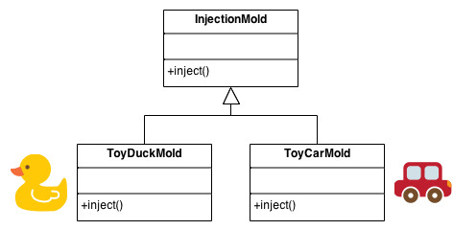
Factory Method Design Pattern
Problem: How do you separate the creation of objects from their use when there are special considerations like:
Complex creation logic
A need for caching
Solution: Create a “Virtual Constructor” called a “Factory” to handle the creation
Notes:
We want to systematically separate the parts of the software that change from the parts that are largely the same – parts that repeat without variation.
Simplification of Abstract Factory
Factory Method is similar to Abstract Factory, but without the emphasis on families.

Slide 17
Keep in Mind with Factory Method…
Someone ultimately has to know about the subclassed factory
Design the arguments to the factory method
What qualities or characteristics are necessary and sufficient to identify the correct derived class to instantiate?
Consider designing an internal “object pool” that will allow objects to be reused instead of created from scratch
Consider making all constructors private or protected

Slide 18

Factory Method: Advantages
Hides complex creation logic
Makes design more customizable and only a little more complicated
Other design patterns often require new classes
Factory Method only requires a new operation
Puts responsibility of creation logic into a separate, cohesive class —Separation of Concerns
Allows for performance enhancements:
E.g., Object caching and Recycling
Notes:
Q6: List a couple of advantages of using a Factory object versus just distributing the logic for deciding what objects to create. [Puts responsibility of creation logic into a separate, cohesive class, Hides complex creation logic, Allows performance enhancements like Object caching and Recycling]

Slide 19
Factory Method: Consequences (1 of 2)
Client code deals only with the product interface; hence, it can work with any user defined Concrete Product classes (decoupling subclass details from client classes)
New concrete classes can be added without recompiling the existing client code
May lead to many subclasses if the product objects requires one or more additional objects (i.e., Parallel Class Hierarchy)

Slide 20
Factory Method: Consequences (2 of 2)
Client needs a manipulator to handle Figure
Rather than having the client aware of the manipulators, this knowledge is encapsulated in the concrete Figure subclasses

Slide 21
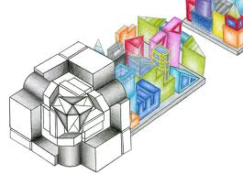
Who creates the Factory?
Several classes need to access Factory methods
Options:
Pass instance of Factory to classes that need it
Provide global visibility to a Factory instance
Dependency Injection
Singleton
Notes:
•• call-outs

Slide 22
Putting the reading in context

Slide 23
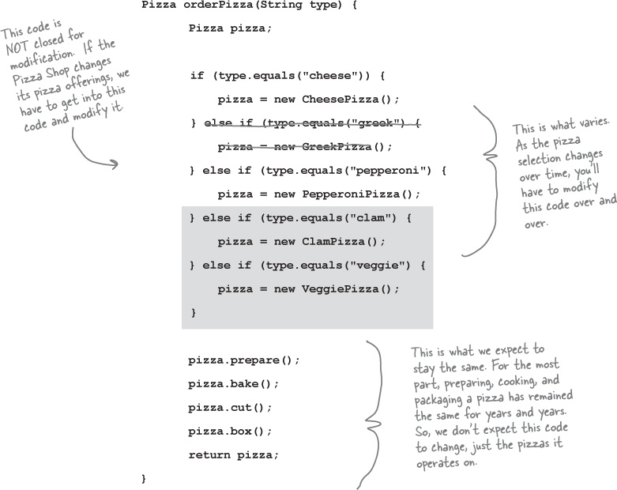
Recall from Reading Chapter 4
Notes:
This code is terrible because we have to keep adding “new” statements to this chain of if statements.
The design is not closed to modification.
In general, factories are designed to solve problems with chains of if statements that create new objects.

Slide 24
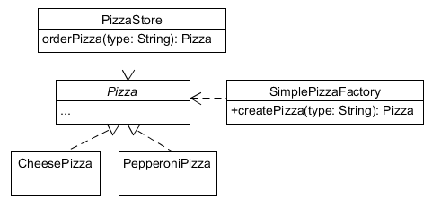
Recall: Simple Factory
Is this design now closed to modification?
public Pizza createPizza(String type) {
Pizza pizza = null;
if (type.equals("cheese")) {
pizza = new CheesePizza();
} else if (type.equals("pepperoni")) {
pizza = new PepperoniPizza();
} else if (type.equals("clam")) {
pizza = new ClamPizza();
} else if (type.equals("veggie")) {
pizza = new VeggiePizza();
}
return pizza;
}
public Pizza orderPizza(String type) {
Pizza pizza;
pizza = factory.createPizza(type);
pizza.prepare();
pizza.bake();
pizza.cut();
pizza.box();
return pizza;
}
Move the complex logic (if’s) into its own method
Notes:
Simple Factory literally just pulls out the if statements into their own class.
That’s good because it follows Single Responsibility Principle.
Is this now closed to modification? NO… we still need to edit existing code to add new pizzas, so it still violates the open/closed principle.
If we extend SimplePizzaFactory to support new pizza types, we are programming to the implementation rather than the interface.
The author leaves us hanging at this point. I thought I would take a moment to demonstrate how we might apply our existing design principles to think about this problem some more…

Slide 25
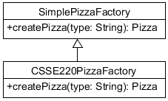
The 220 student strikes again…
public Pizza createPizza(String type) {
Pizza pizza = super.createPizza(type);
if (pizza == null) {
if (type.equals("sausage")) {
pizza = new SausagePizza();
}
}
return pizza;
}
The 220 student extended the factory with a subclass.
Does this approach fix the design?
Notes:
This fixes the open/closed violation!
But, it introduces coding to an implementation.
People using the 220 factory are depending on the simple pizza factory to still create cheesepizzas etc.

Slide 26
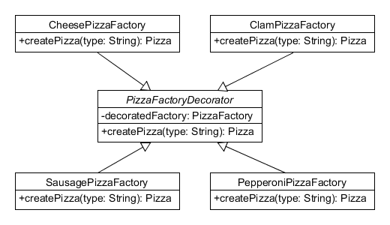
What about Decorator?
factory = new ClamPizzaFactory(
new PepperoniPizzaFactory(
new CheesePizzaFactory() ));
…
factory = new SausagePizzaFactory(factory);
Notes:
Decorator is our standard solution to these types of problems.
But, as far as I know, this is not really a thing.

Slide 27
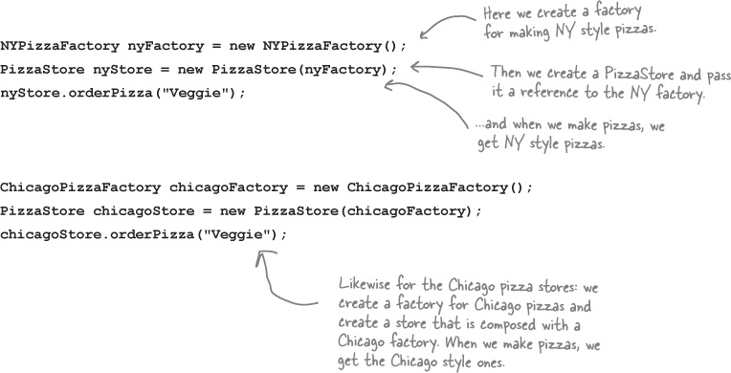
Supporting Regional Pizza
But maybe we don’t like decoupling
the store from the factory?
Notes:
For example: maybe we want a NY pizza themed store that prepares the pizza in the NY style.

Slide 28
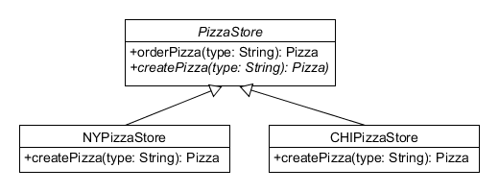
Factory Method
Use subclasses instead of Factories
public class NYPizzaStore extends PizzaStore {
Pizza createPizza(String item) {
if (item.equals("cheese")) {
return new NYStyleCheesePizza();
} else if (item.equals("veggie")) {
return new NYStyleVeggiePizza();
} else if (item.equals("clam")) {
return new NYStyleClamPizza();
} else if (item.equals("pepperoni")) {
return new NYStylePepperoniPizza();
} else return null;
}
}
public abstract class PizzaStore {
abstract Pizza createPizza(String item);
public Pizza orderPizza(String type) {
Pizza pizza = createPizza(type);
System.out.println("--- Making a " +
pizza.getName() + " ---");
pizza.prepare();
pizza.bake();
pizza.cut();
pizza.box();
return pizza;
}
}
Notes:
PizzaStore (in particular, createPizza) is now abstract; you now create specific regional pizza by subclassing, while reusing the same orderPizza.
Instructor’s note: this is Template Method, so this is why this factory method is ok but simple factory is not.

Slide 29
Two issues with Factory Method
Creates Parallel Class Hierarchies
Violates Dependency Inversion Principle (DIP)
public class NYPizzaStore extends PizzaStore {
Pizza createPizza(String item) {
if (item.equals("cheese")) {
return new NYStyleCheesePizza();
} else if (item.equals("veggie")) {
return new NYStyleVeggiePizza();
} else if (item.equals("clam")) {
return new NYStyleClamPizza();
} else if (item.equals("pepperoni")) {
return new NYStylePepperoniPizza();
} else return null;
}
}
Take a moment to convince yourself that this is the case.
Notes:
After a moment, ask: why is this the case?
In the book, the author mentions that the difference between NY and CHI pizza is the ingredients. For instance: both regions use pizza dough, but they use different kinds of pizza dough.
We can take advantage of this fact to depend on interfaces instead an implementations. This change also creates parallel sets of ingredients, which are really what changes, instead of pizzas, which are what stay the same.

Slide 30
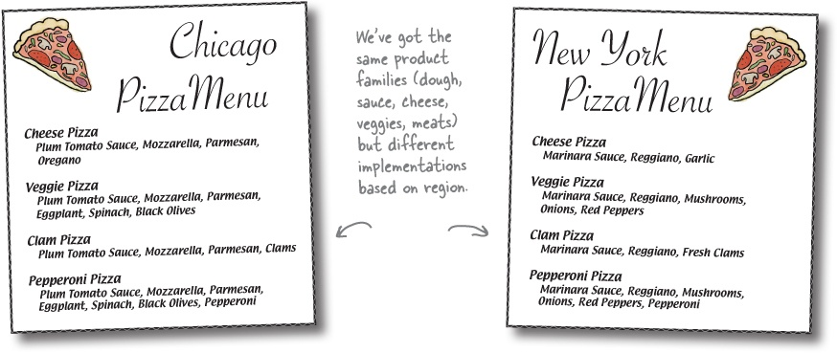
What changes? What stays the same?

Slide 31
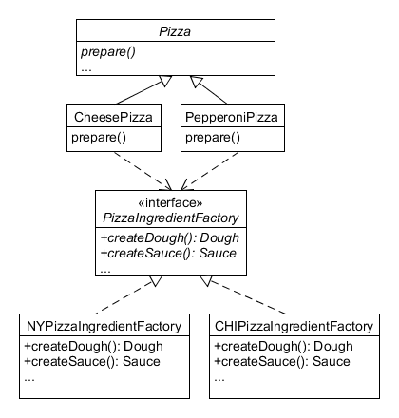
Abstract Factory
Apply DIP to separate what changes, the regional ingredients, from
what stays the same, the pizza names and preparation.
Pepperoni pizza prep stays the same.
public void prepare() {
System.out.println("Preparing " + name);
dough = ingredientFactory.createDough();
sauce = ingredientFactory.createSauce();
cheese = ingredientFactory.createCheese();
veggies = ingredientFactory.createVeggies();
pepperoni = ingredientFactory.createPepperoni();
}
Dependency inversion is here.
public Dough createDough() {
return new ThickCrustDough();
}
public Sauce createSauce() {
return new PlumTomatoSauce();
}
Notes:
See how the arrows point at each other? That is Dependency Inversion.
Q: How does the PepperoniPizza find out about its PizzaIngredientFactory?

Slide 32
Problems with AbstractFactory
Someone has to instantiate the factory – but there is no good place to do this.
Java solves this problem with autowiring values into declared variables.
We will look at this next week.
// Who knows where the concrete class comes from? Who cares?
@Autowired
PizzaIngredientFactory ingredientFactory;
Notes:
Too close to user: violates DIP.
Too far away from user:
Complicates construction.
We may need another factory method!

Slide 33
Problems with AbstractFactory
What if we want more ingredients?
Example: strawberries in a StrawberryPizza.
What code do we write?
Notes:
Prepare for sadness - AbstractFactory does not handle the case where we might want new ingredients.
The factory is still not closed to addition of new ingredients.
Mark: this is one of the unaddressed questions that perplexed me about the author’s explanation of factory.
But some might argue that’s ok: it follows Single Responsibility Principle.

Slide 34
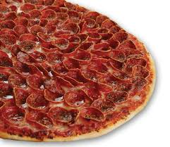
Why not Strategy Pattern?
// Program to interface, not implementation.
Ingredient dough;
Ingredient sauce;
…
void prepare() {
System.out.println("Preparing " + name);
dough = ingredientFactory.create("DOUGH");
sauce = ingredientFactory.create("SAUCE");
cheese = ingredientFactory.create("CHEESE");
veggies = ingredientFactory.create("VEGGIES");
pepperoni = ingredientFactory.create("PEPPERONI");
}
Cheese pizza?
// Sriram wants NY pizza with Chicago-style cheese.
nyIngredientFactory.addIngredient("CHEESE",
new CHIPepperoniStrategy());
sriramPizza = new CheesePizza(nyIngredientFactory);
sriramPizza.prepare();
…
Nothing can go wrong by throwing out type safety.
Notes:
Mark: there is an intentional typo on this slide. It creates pepperoni rather than cheese to demonstrate the perils of programming too abstractly.
Now I can easily add new ingredients to the factory, even ones the author did not know about, by calling addIngredient!
That seems like the best design, right??
The problem here is now create must return a common Ingredient interface. That’s fine unless you really need to create a specific kind of ingredient and know it is that kind of ingredient.
Otherwise, you can get into situations where people are swapping the bag of cheese with the bag of pepperoni and Sriram, who ordered a cheese pizza, gets a pizza covered in pepperoni instead.
The choice of type safety over flexibility is an intentional design tradeoff made by the people who write AbstractFactories.

Slide 35
4-1 Design Studio

Slide 36
Starbuzz Coffee Decorator Solution

Slide 37
Lab 4-1: Widget Factory for OS’s!
Review Lab 4-1 Assignment
Load Lab4-1.zip from Moodle into a workspace using instructions in Folder
If time, start working on it

Slide 38
Homework and Reading Reminders
Milestone 2 Design Studio in Class
Thursday, December 20th, 2018
Lab 4-1 on Factory Design Pattern.
Due 5:30pm Friday, December 21st, 2018
Read assignment write-up carefully (TA sign-offs)

